Slide 1
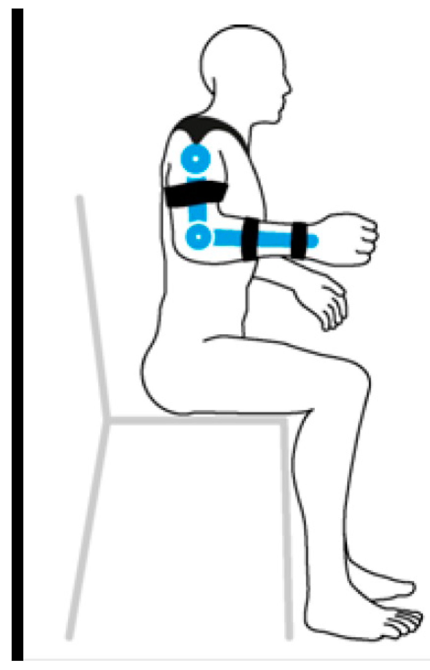
Case Study Motion For Upper Limb

Slide 2





Table of content
Comparative Analysis of Arm Range of Motion
Introduction
Control Algorithms in Upper Limb Orthotic Devices
ROM Restrictions
Programs used in project
Improving ROM
Upper Limb Model Development
Analyzing Arm & Elbow
Data Processing
Conclusion

Slide 3
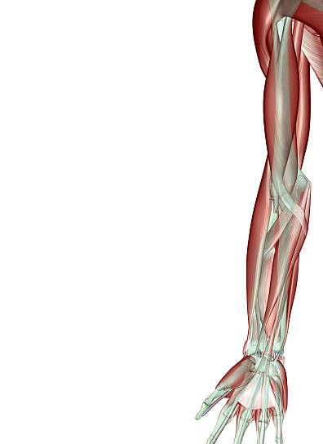
Introduction
Upper limb rehabilitation is vital for individuals with arm disabilities. Recent technological advances, like robotic-assisted therapy and advanced control algorithms, offer promising solutions. Robotic therapy engages patients through exoskeleton systems and virtual reality, enhancing outcomes. Control algorithms, including EMG-based and IMU sensors, enable precise movement control. Key programs like OpenSim and Qualisys facilitate accurate modeling and motion tracking. These advancements hold potential for improving rehabilitation outcomes and enhancing the lives of individuals with upper limb disabilities.

Slide 4
Control Algorithms in Upper Limb Orthotic Devices
EMG-Based Control
Force Myography (FMG)
Inertial Measurement Unit (IMU) Sensors

Slide 5
Programs used in project
OpenSim
OpenSim Creator
Qualisys

Slide 6
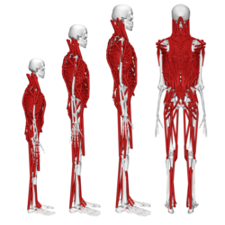
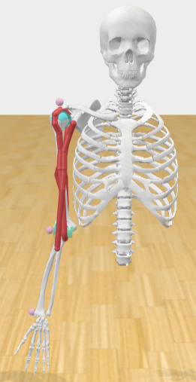
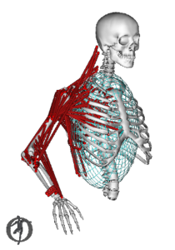
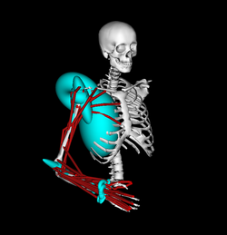
Upper Limb Model Development
Full-body models with detailed thoracolumbar spine.
Arm 26 Model
Arm 26 Model
Arm 26 Model

Slide 7
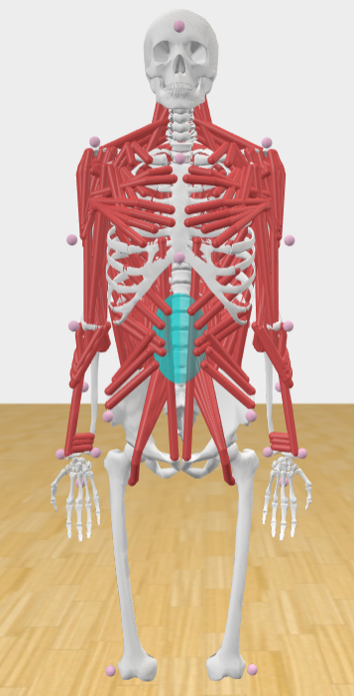
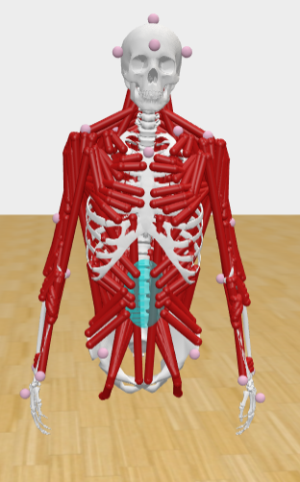
Final Model
Model Before editing.
Final Model

Slide 8
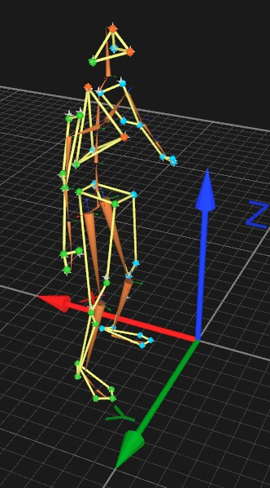
Data Processing
Data Source
Validation of Data Using AIM Model in QTM
Importance of Standardizing Data Formats

Slide 9
Data Conversion and Processing
Conversion of Data Formats (QTM to C3D)
Use of C3DTools for Efficient Data Conversion
Challenges with .mot Files and Solution with OpenSim Inverse Kinematics

Slide 10
Graphical Analysis and Reference Preparation
Generation of Motion Files for Graphical Analysis
Preparation of Graphs as Reference for Movement Assessment

Slide 11
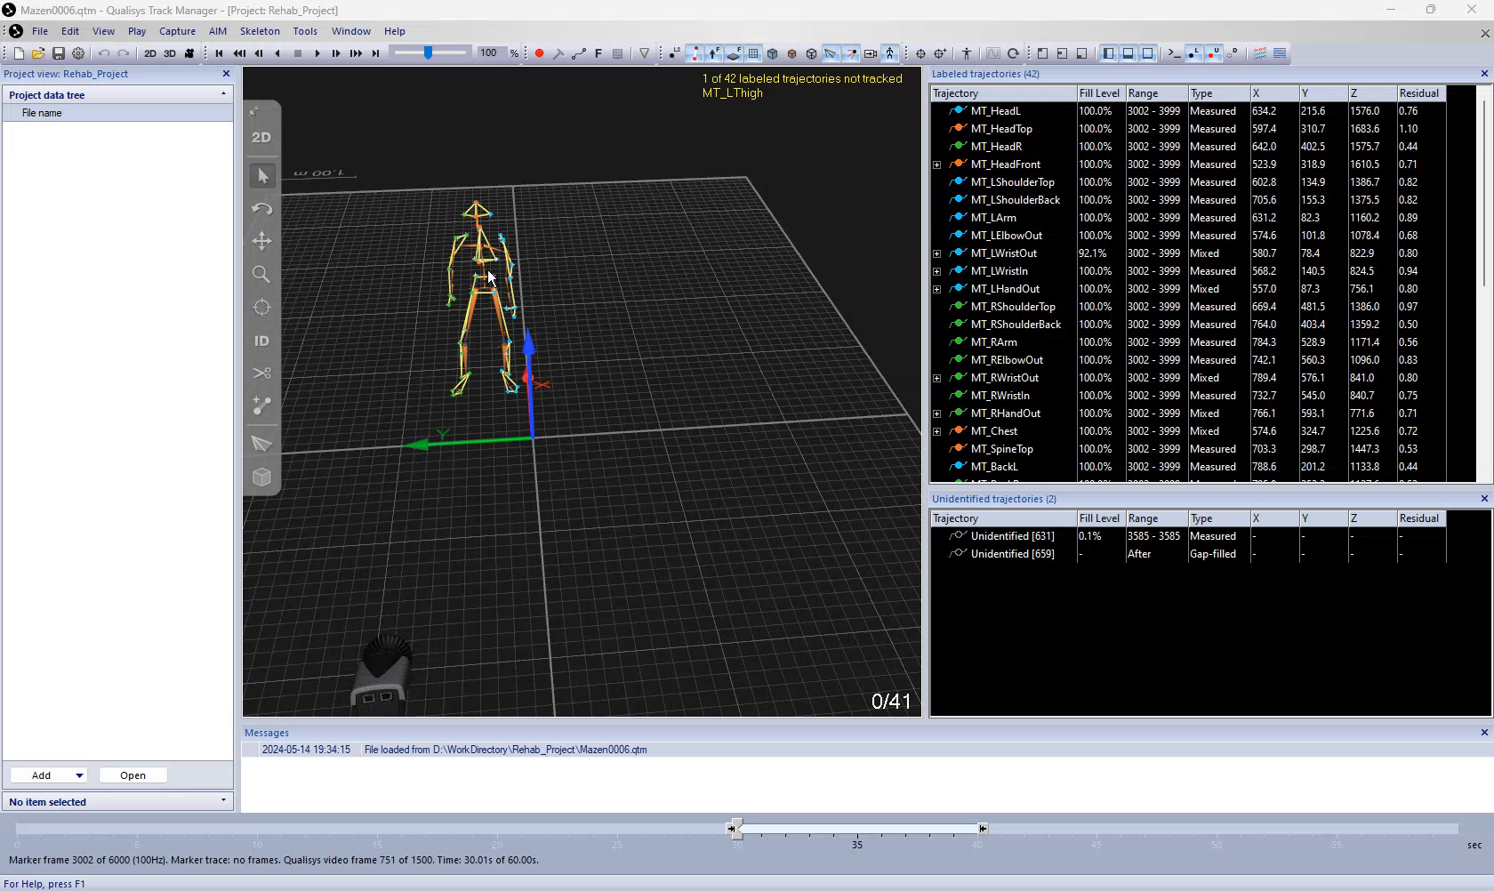
QTM Motion

Slide 12
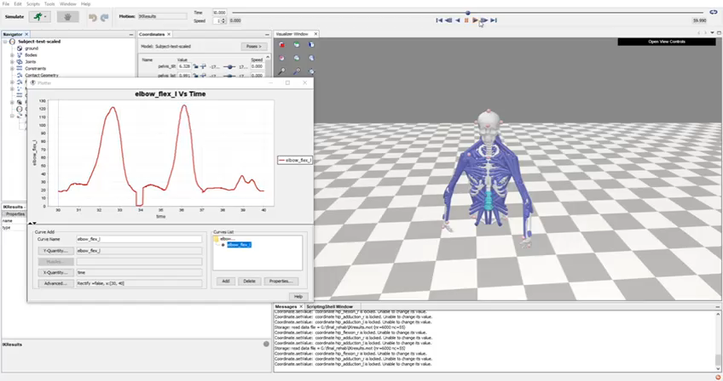
Opensim Motion

Slide 13
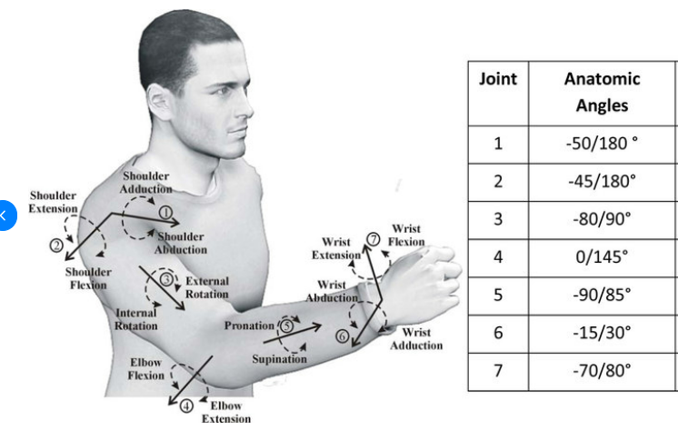
Comparative Analysis of Arm Range of Motion
ROM of Arm for Well Person
Joint | Anatomic Angles
Arm Flexion | From -45 to 180 degrees
Arm Adduction | From -50 to 180 degrees
Arm Rotation | From -80 to 90 degrees
Elbow Flexion | From 0 to 145 degrees
Figure 15: Basic Motion of Human Arm

Slide 14
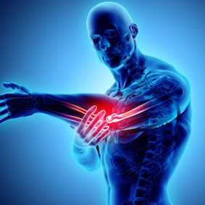
ROM Restrictions
Pain
Injury
Muscle Weakness
Figure 16: Elbow Pain

Slide 15
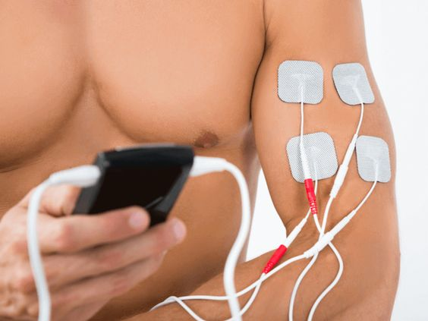
Improving ROM
Several assistive rehabilitation devices can be utilized to improve the range of motion (ROM) of the arm and elbow:
Passive Range of Motion (PROM) Devices
Electrical Stimulation Devices: like Neuromuscular Electrical Stimulation (NMES), and Transcutaneous Electrical Nerve Stimulation (TENS).
Assistive Devices for Activities of Daily Living (ADLs)
NMES for Biceps

Slide 16
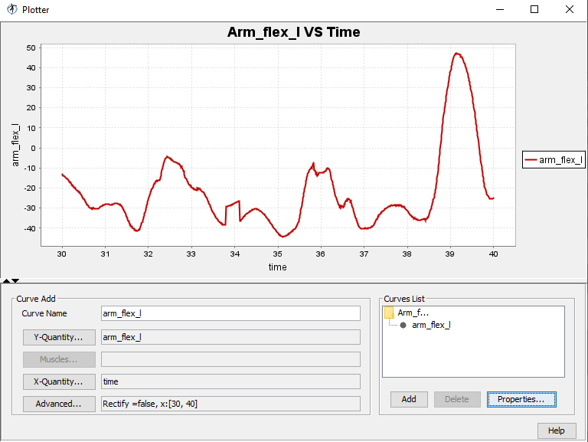
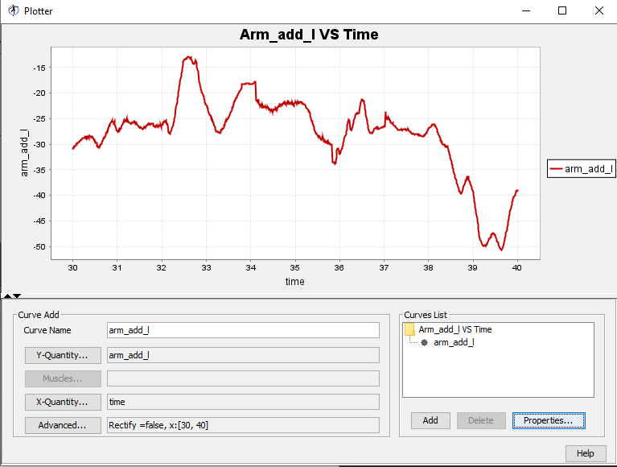
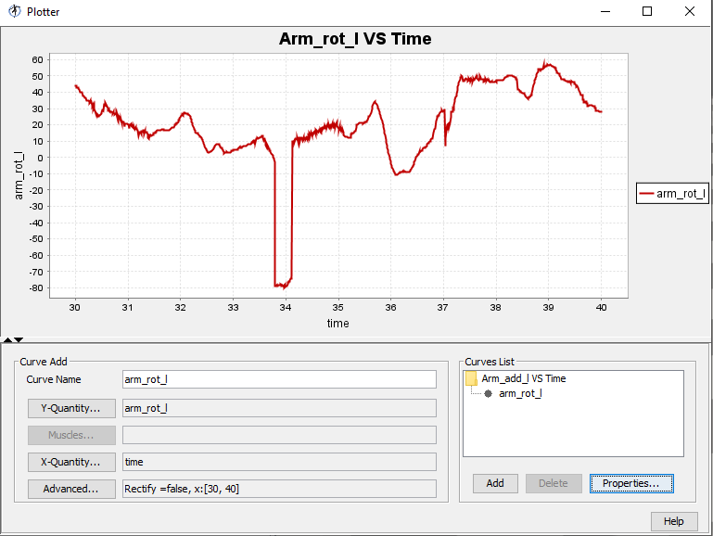
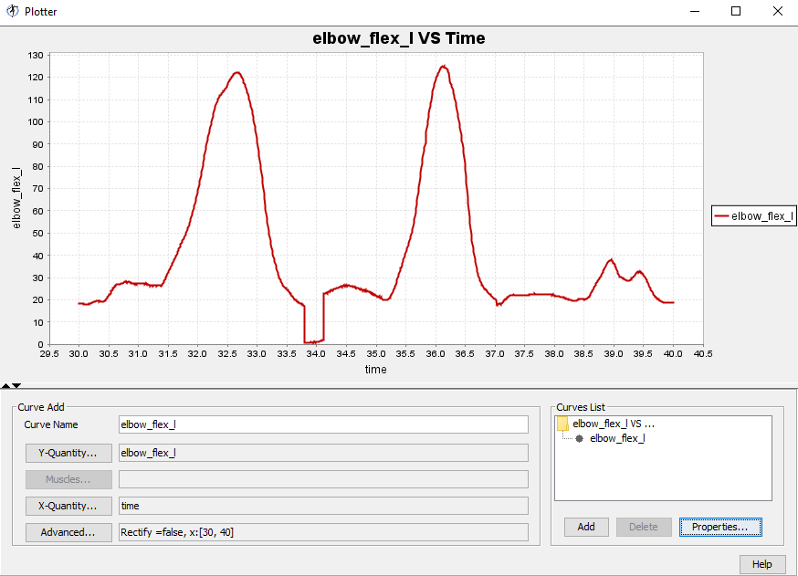
Analyzing Left Arm

Slide 17
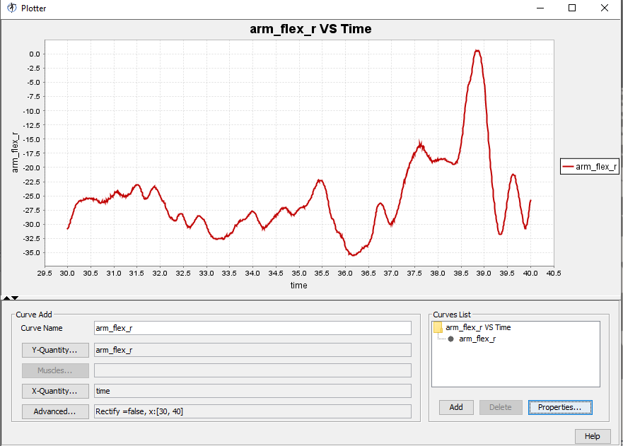
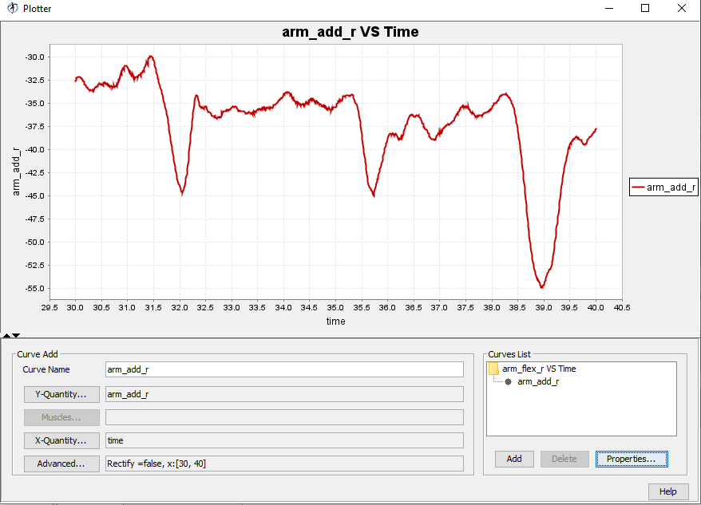
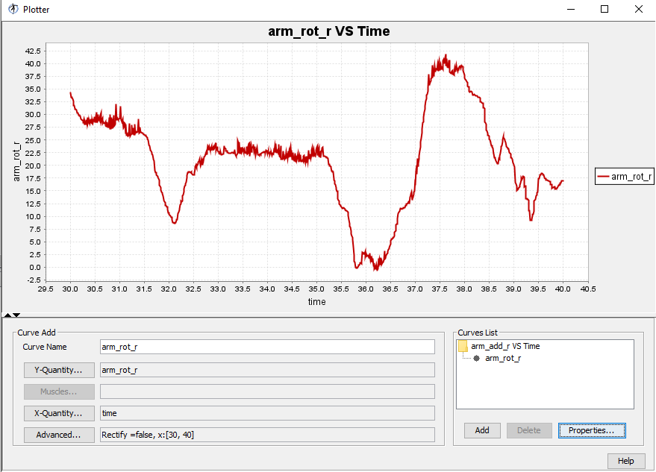
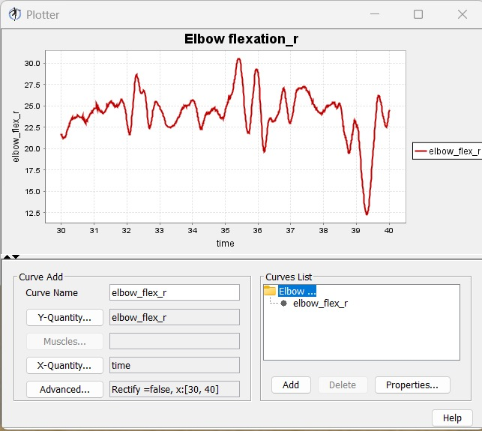
Analyzing Right Arm

Slide 18
Conclusion
Motion Capture Analysis:
Both arms achieved expected Range of Motion (ROM).
Variations observed between left and right arms.
Importance of Assessing Arm ROM:
Crucial for rehabilitation planning.
Helps address specific limitations.
Role of Assistive Devices:
Crucial for enhancing ROM and functional outcomes.
Includes CPM machines, therapeutic equipment, orthoses, stimulation, and VR programs.
Benefits of Assistive Devices:
Strengthen muscles and improve joint mobility.
Address movement asymmetries, optimizing interventions.
Enhancing Quality of Life:
Optimizing ROM improves quality of life for individuals with arm issues.

